Slide 1
Apply List webpage
Teyi Tsai
11/26/2020 assignment 5

Slide 2
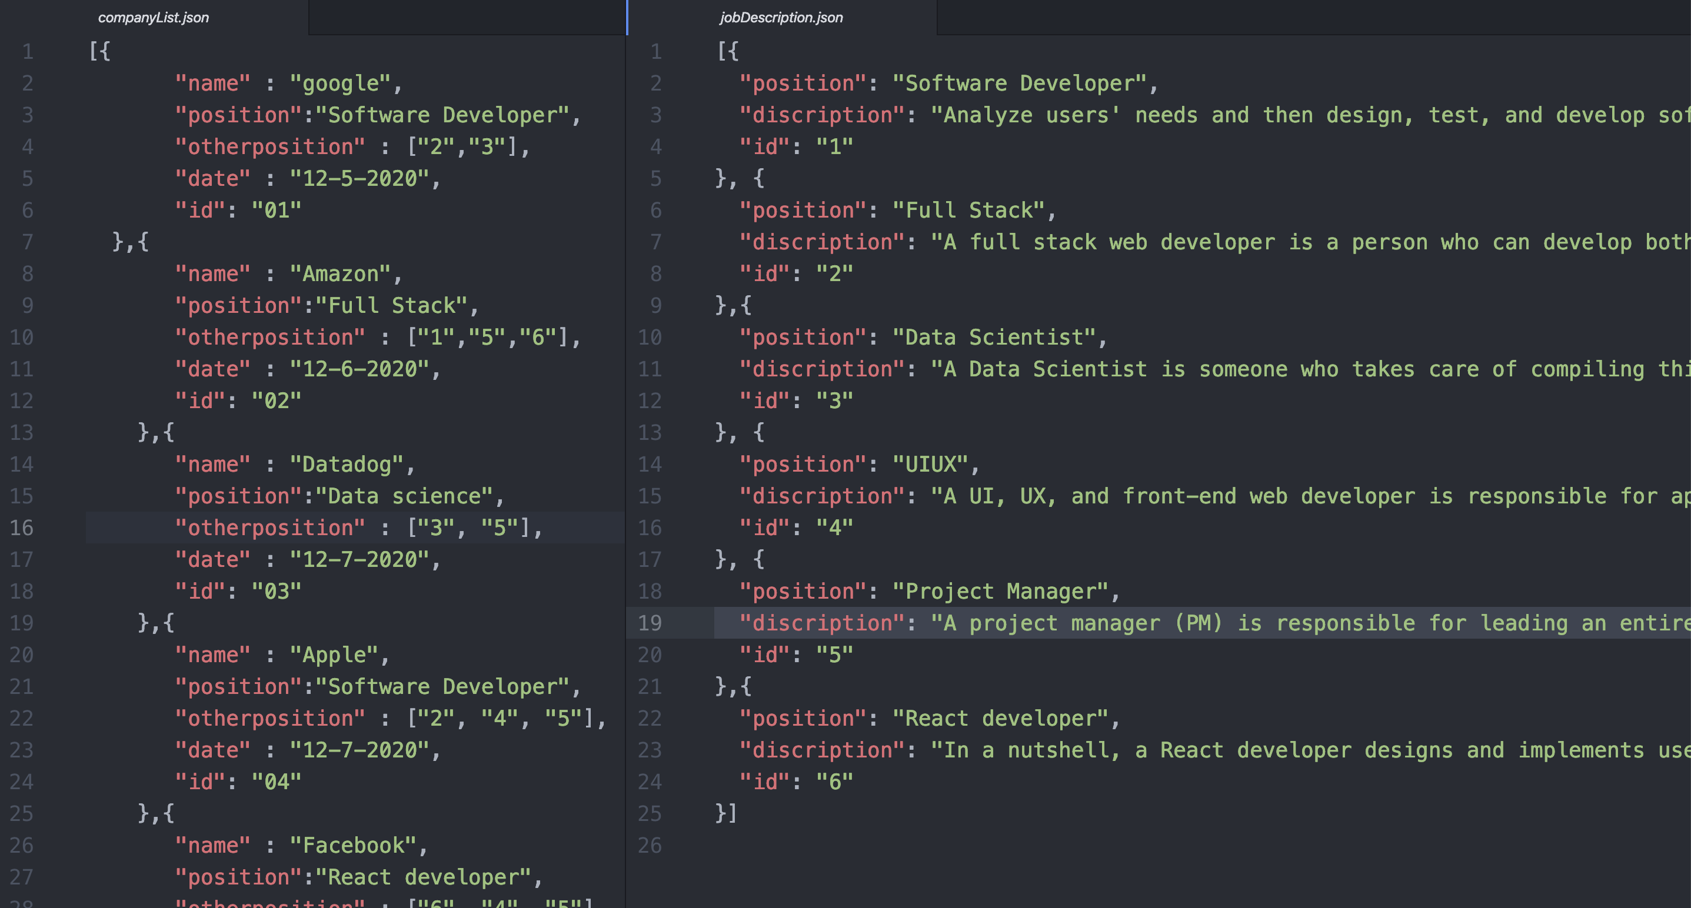
Using JSON data
Including two json file, companyList.json and jobDescription.json
The companyList.json contain the data that the user apply and also the comply’s other position that are opening, display by foreign key id. the second file in the right (jobDescription.json) give a job description.
The second table works like a look up table and help to display the data in /position/:id

Slide 3
API Explain
/listApplied - it get all the list of Application that the user apply. The company title, the date that applied and the position that the user apply.
/listApplied/id - user could press the detail and see each job in page. Is this situation, RESTapi according to it’s id to fetch its data.
/listApplied/id/otherpostion - the RestfulAPI check on it’s other position according to the company.
/listApplied/id/otherpostion/jobId - according to the job Id that the company have it display it’s job discretion. If the company dose not have the job it will display an error message.

